Slide 1
CI IP Blockchain Incubation
Workstream “Location Data Management” (LDM)
Location Data Management
facilitated by
Capgemini

Slide 2
Blockchain Incubation
WiP DRAFT
Key events: Ideation Phase for ‘Location Data Management’
Workstream “Location Data Management” by Capgemini
Preparation Phase
Ideation Phase
28.09. (Thu): 5pm-6:15pm
1st Sponsor Meeting: Objectives
@ ZUA & Webex
02.10. (Mon): 5pm-6:15pm
BC Demo by Capgemini
@ ZUA
12.10. (Thu): 5pm-9pm
‘Run-Trough’ & Dinner
@ ZDC (tbc)
04.10. (Wed)
10:30am-12:pm & 2:30pm-4pm
2nd Sponsor Mtg: Design&Content
@ ZUA
13.10. (Fri): 8am-6pm
Ideation WS
@ ZDC (tbc)
T I M E L I N E

Slide 3
Blockchain Ideation for “Location Data Management” (LDM)
WiP DRAFT
Overview
TEAM STRUCTURE
MEETING / WORKSHOP SCHEDULE
1
4
# Date Meeting Venue Duration
1 Sep 28 (Thu) Kick-off & ZUA/Telco 1h
5pm-7pm Objectives
2 Oct 4 (Wed) Design & ZUA/Telco 1.5 (am) + 1.5h (pm)
10:30am-12pm Content
2:30pm-4pm
3 Oct 12 (Thu) Run-Through & ZDC 3-4h (pm) incl. dinner
5pm-9pm Dinner
4 Oct 13 (Fri) Ideation ZDC full day
8am-5pm Workshop
Executive Sponsor
Supplier Capgemini (CG)
Susan Fallon (UK-LDN)
Global Head of Commercial Property
Ash Kumar (UK-LDN)
ASE Workshop Moderator
Portia Light (UK-LDN)
ASE Workshop Co-Facilitator
Thomas Wilson (CH-ZRH)
Blockchain SME CH
Kevin Tran* (US-HOU)
BC / Solution & Innovation Specialist
Mayank Dobhal*
FS CH CoE (IN)
Franziska Klaus (CH-ZRH)
PM / Engagement Lead
2
Operational Sponsors (SMEs)
Claude Haueter (CH-ZUA)
NEO
Stefan Fadler (DE-FFM)
Head of UWS Liability
Bart van den Broeck (CH-ZUA)
UWR Property for Standalone Countries
Ertekin Aydemir (CH-ZUA)
Underwriter Property IPZ
5
tbc: Supplier SME Deon Digital (DD)
OBJECTIVES AND EXPECTED OUTCOMES
Xxx (CH-ZRH)
Xxx
1st Sponsor Meeting:
Objective Outcome
2nd Sponsor Meeting:
Objective Outcome
“Run-Trough” Session (evening before Ideation WS):
Objective Outcome
Ideation WS:
Objective Outcome
3
Incubation Program / Project Lead
6
Tony Wainner
Head of CI IP IT
Armin Schaefer (CH-ZUA)
Head of Digital & New Technology
Chong-Gu Ra (CH-ZUA)
Project Manager Blockchain Incubation
Zurich Blockchain Key Stakeholders
Alessandro Spadoni (CH-ZUA)
Chief Architect
Anthony Elliott (CH-ZUA)
Group Head of Business Transformation
REQUIRED INPUT FOR WS PREP (to be provided by SMEs)
Questionnaire (provided by Capgemini => to revert filled by SMEs):
…
…
Other Input to be provided to Capgemini:
…
…

Slide 4
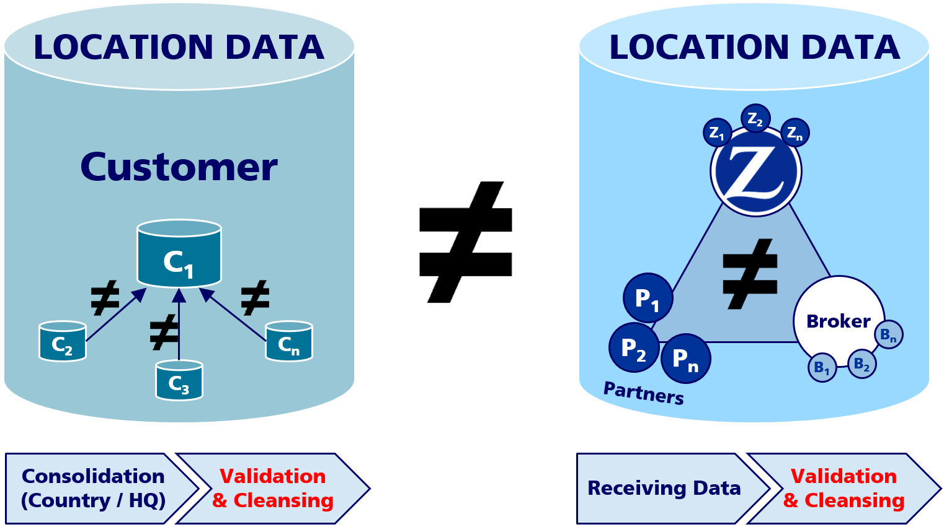
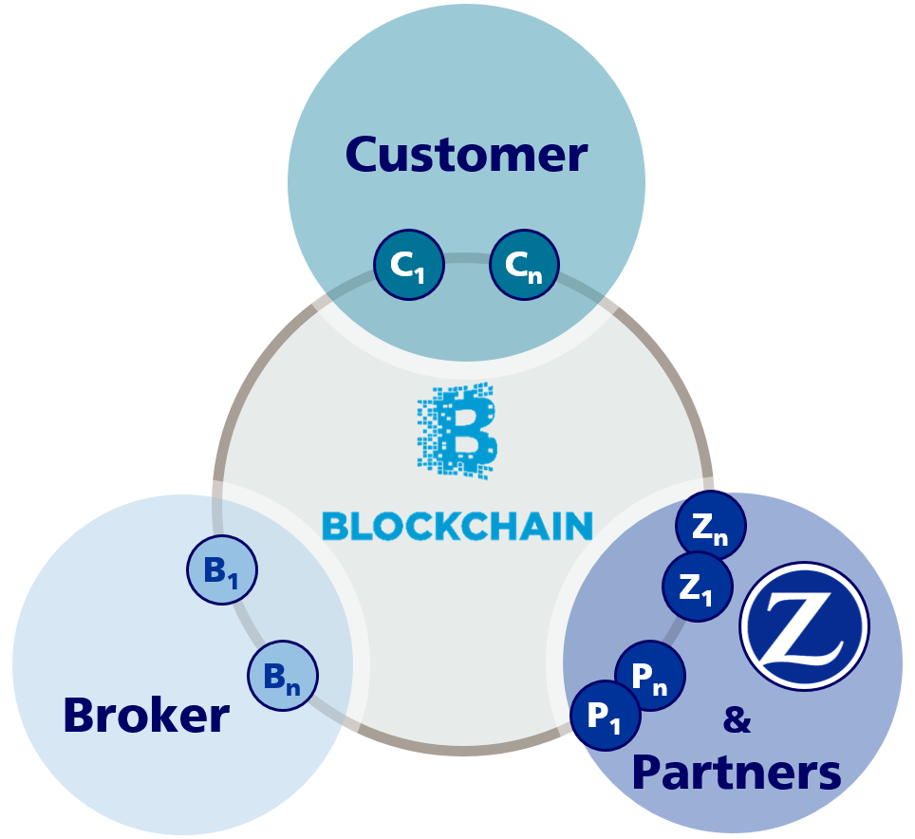
BLOCKCHAIN FOR LOCATION DATA MANAGEMENT
TO BE USED TO INVITE CUSTOMERS
Jointly resolving key pain points to avoid recurring costs and efforts
LOCATION DATA CHALLENGES SHARED BY CUSTOMERS AND ZURICH
Recurring and high efforts for Customers and Zurich to ensure consistent and complete location data to be shared
Avoidable costs for clients, brokers, partners and Zurich to obtain consolidated and clean location data during renewal period each year
Key pain points cover (a) time and resource consumption for manual reconciliations, data verification and cleansing as well as for (b) usage of IT/DWH capacities
THE BLOCKCHAIN TECHNOLOGY PROMISES A SMART SOLUTION TO OUR PROBLEM
The Blockchain has the potential to ensure the Single-Source-of-Truth and enables continuous updates of location data at the time of any information changes with a high degree of automation supported by the usage of smart contracts, which will ultimately result in: RISK COST SPEED QUALITY
CURRENT STATE
TARGET STATE
The Blockchain is a controlled environment, where only mutually agreed exposure/location data are made visible/accessible to other members of the Blockchain.
Such information shall be (instantly) updated, once a change of data by the customer, broker (or any of their affiliates) or partner is been made.
Additional information can be stored on the Blockchain, which is not visible/ accessible to any other party, which still can use the advantages of the Blockchain technology (i.e. Immutability, authenticity, composability, smart contracts).
[…]
[…]
[…]
[…]
CURRENT PAIN POINTS
TARGETED BENEFITS
Redundancies data storage
Manual re-keying efforts
Lack of overall consistencies and feedback loops for cleansing at source
Location data is only assessed and updated once a year during renewal
which result in unnecessary overconsumption of attention, time and resources
Single-Source-of-Truth at any given time
Continuous updates of verified, consolidated, cleansed and complete property location / geo-coded data
Efficiency gains by avoiding re-keying
Network effects for customers are beyond insurance itself
BE INVITED TO JOIN US TO COLLABORATE AND BENEFIT FROM OUR EXCITING BLOCKCHAIN JOURNEY!

Slide 5
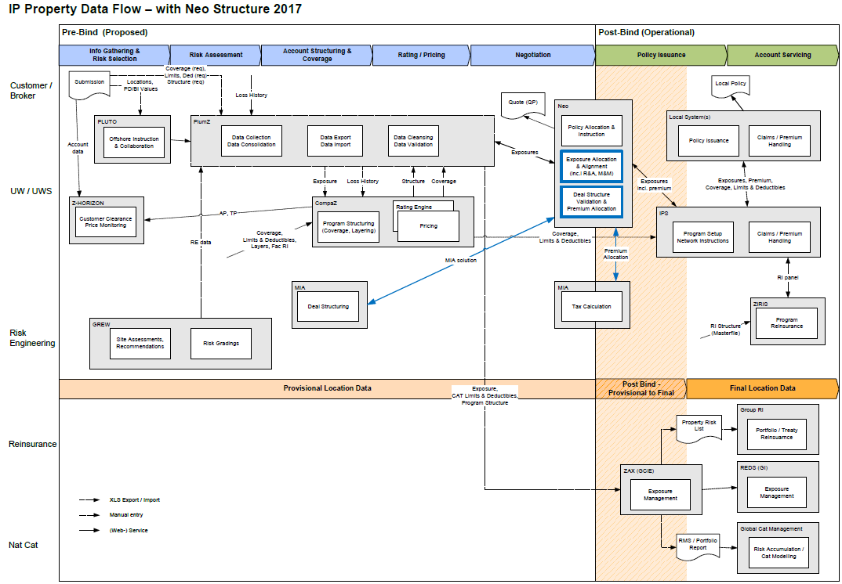
BLOCKCHAIN FOR LOCATION DATA MANAGEMENT
Attributes Scope for Inception (new policies), Renewal (annual policy renewals) and Adjustments (during the year)
Data Zone
Attributes
Primary SCOPE
Public
(to be shared with 3rd parties)
Around 30 attributes
Private
(ZH internal)
Additional 350 attributes
ZH internal:
Risk Engineering
Pricing
Deal Structuring
Assessment Information
Etc.

Slide 6
Primary
SCOPE

